Slide 1

Vectrosafe
Powered by BTPNS
Fuad Zauqi Nur
Final Project
2020
BTPNS Shifted Batch 2

Slide 2
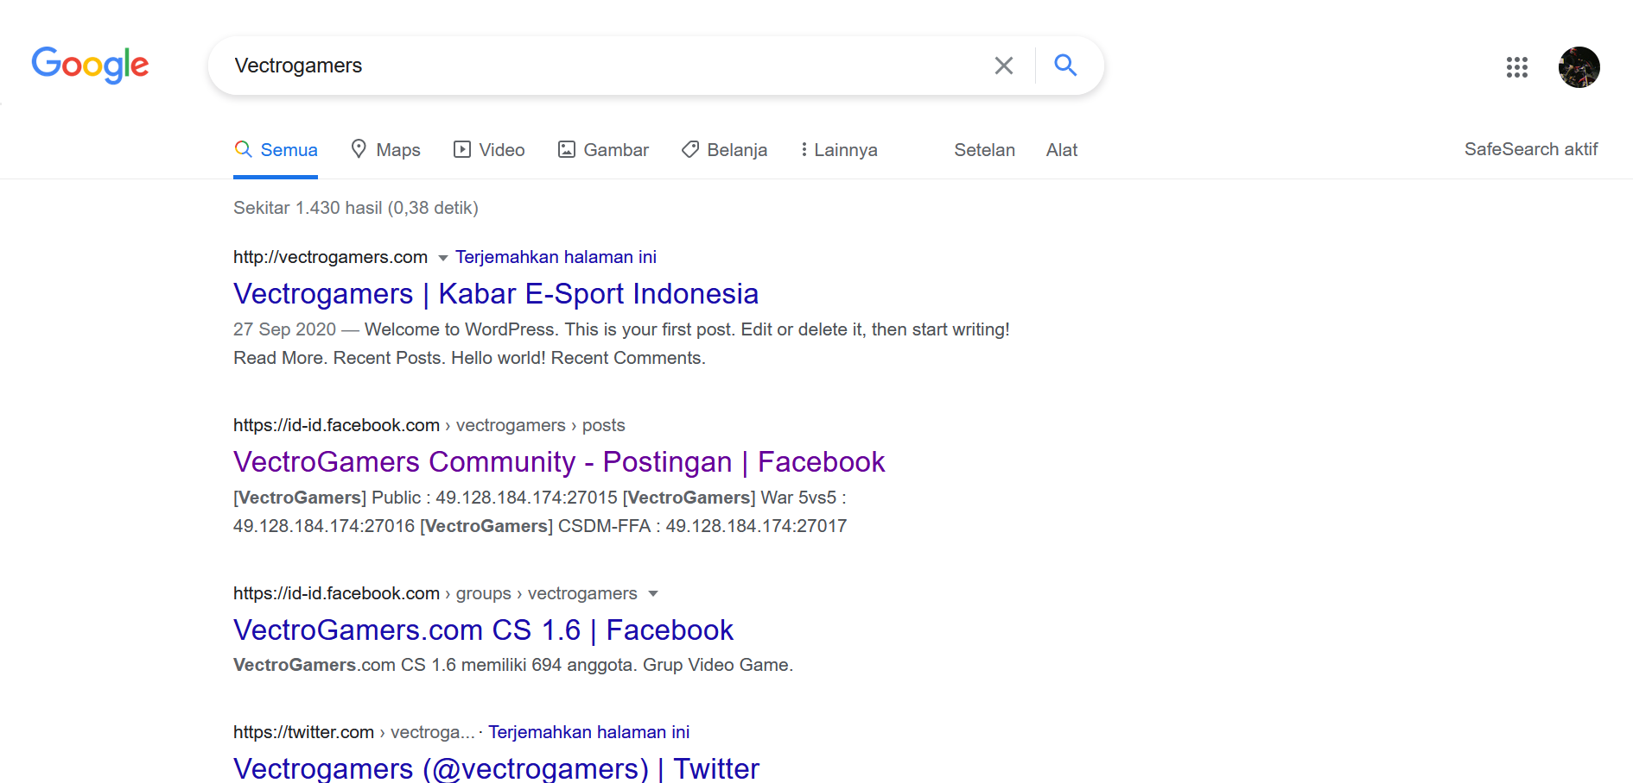

Vectrosafe?

Slide 3
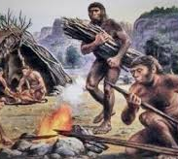
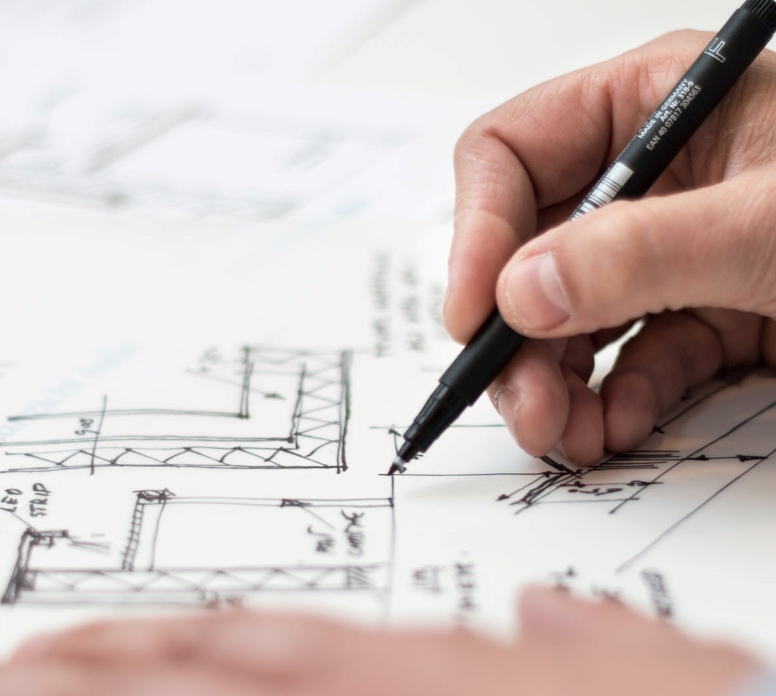
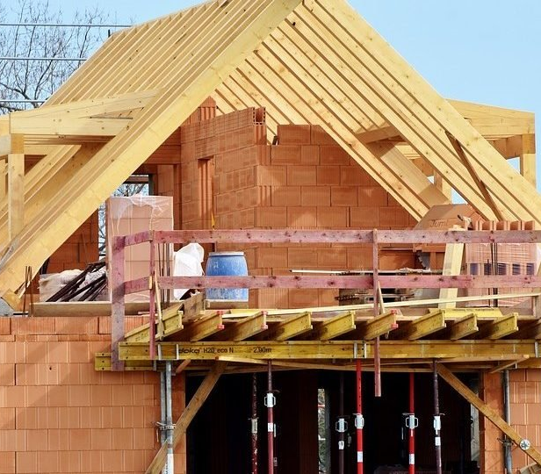

Alur Pengembangan Aplikasi

Slide 4







Perencanaan
?

Slide 5
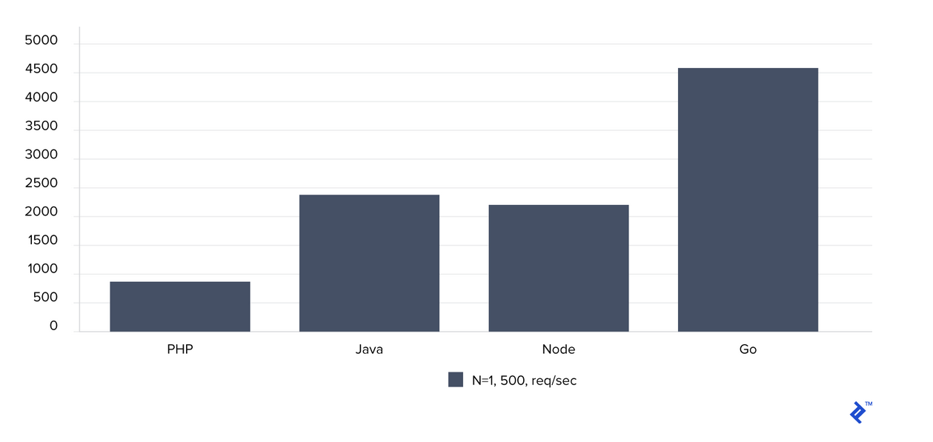
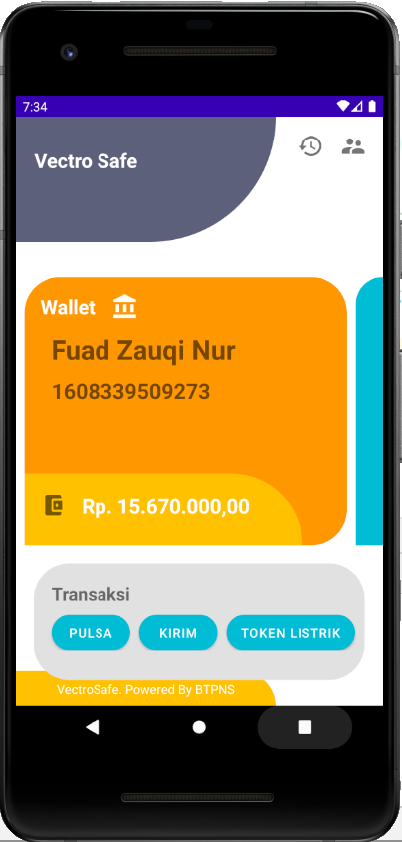
Mengapa Java?
Total number of requests per second. Higher is better.

Slide 6
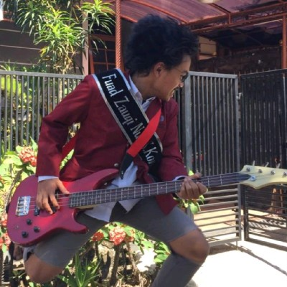
Quote of the Day
Naek motor mah ngebut aja dulu, urusan jatoh belakangan.
Fuad Zauqi Nur

Slide 7
Infrastruktur
RabbitMQ?
Java?
Performa yang baik
Komunikasi Microservice tercatat
Mudah diimplementasikan
Sistem Antri (Queue)

Slide 8
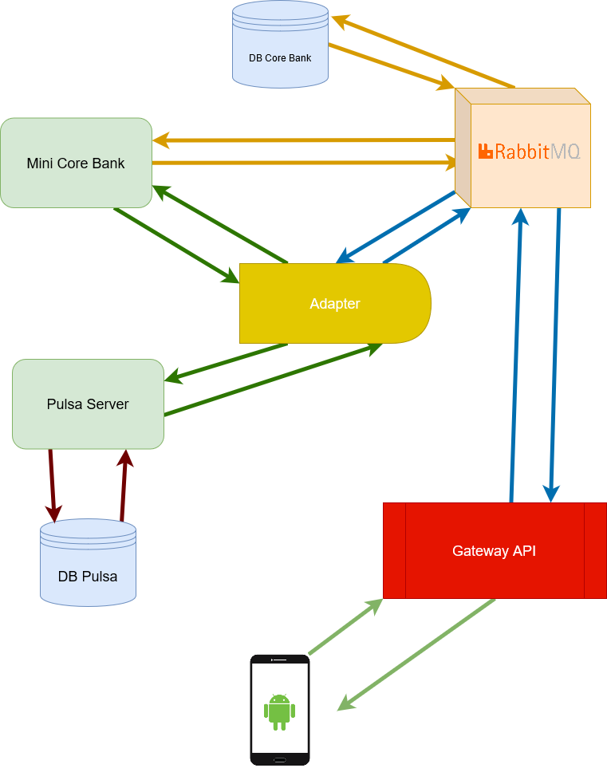
Back-End

Slide 9
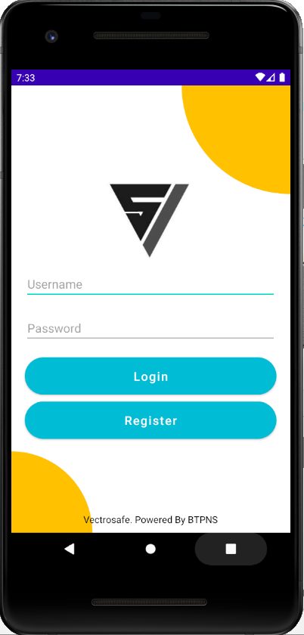
Front -End

Slide 10
Thank You

